Slide 1
Problem Session:
Named Reactions
Fahima Idiris
22nd April 2020

Slide 2
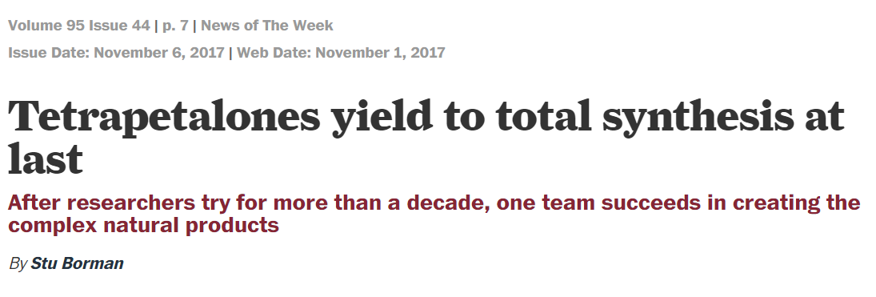
J. Am. Chem. Soc., 2017, 139, 14901–14904.
With the amount of effort that has been expended on trying to synthesize the tetrapetalones, “you might think that they cure cancer,” says Thomas Pettus of the University of California, Santa Barbara. “Sadly, this is not the case. They just have a really interesting architecture”. – (c&en news, 2017)

Slide 3
Question 1
J. Am. Chem. Soc., 2017, 139, 14901–14904.

Slide 4
Question 2
J. Am. Chem. Soc., 2017, 139, 14901–14904.
Sterically encumbered Lewis acid aluminum complex gave the 1,4-addition product exclusively.
Yamamoto, J. Am. Chem. Soc. 1994, 116, 4131-4132.

Slide 5
Question 3
J. Am. Chem. Soc., 2017, 139, 14901–14904.

Slide 6
Question 3
J. Am. Chem. Soc., 2017, 139, 14901–14904.

Slide 7
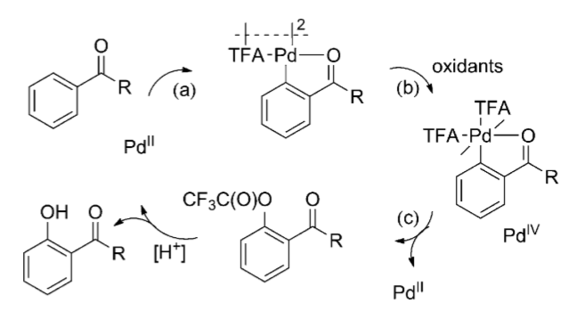
Question 4
J. Am. Chem. Soc., 2017, 139, 14901–14904.
Pd-Catalysed C-H Oxygenation
Angew. Chem. Int. Ed. 2012, 51, 13070–13074.

Slide 8
Question 5
J. Am. Chem. Soc., 2017, 139, 14901–14904.
Luche Reduction

Slide 9
Question 5
J. Am. Chem. Soc., 2017, 139, 14901–14904.
Alkylation

Slide 10
Question 6
Triflation
J. Am. Chem. Soc., 2017, 139, 14901–14904.
Intramolecular Heck reaction

Slide 11
Question 7
J. Am. Chem. Soc., 2017, 139, 14901–14904.
Oxidation: Tetrahedron Letters, 2008, 49, 2764–2767

